Slide 1

Warm welcome to our international students at Pforzheim University!
IT Guide Summer 2018

Slide 2
ISP Downloads
Where do I find all presentations and documents from the introduction sessions?
Go to
www.hs-pforzheim.de/isp/downloads

Slide 3
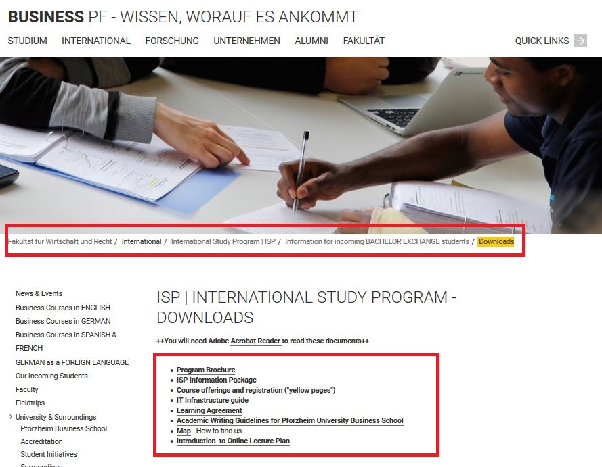

Slide 4
How to get connected to the University IT
How and where do I use my student ID card?
How do I access and work with my Pforzheim University user account (and webmail)?
Where can I find guidelines /software on how to connect my notebook to the university wireless internet software (VPN client)?
How do I copy, scan and print at the Multifunctional Copy Machines?
How do I connect to Wireless internet?
E-learning (Moodle) registration

Slide 5
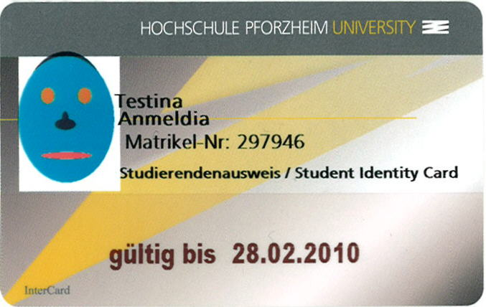

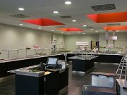

How and where to use student ID card?
Student ID card is not only used as an authentication
as a student at the Pforzheim University, but:
  Cash free payment at „Mensa“ (cafeteria) and vending machines
  Login at multifunctional copy machines all over campus
  Library ID card
  Door opener: main entrances / computer labs (some labs need specific activation)
  „Studiticket“ for bus and public transport
  Very important: your student ID is only activated and ready to be loaded with money after your user account is activated through initial login at the multifunctional printer!

Slide 6
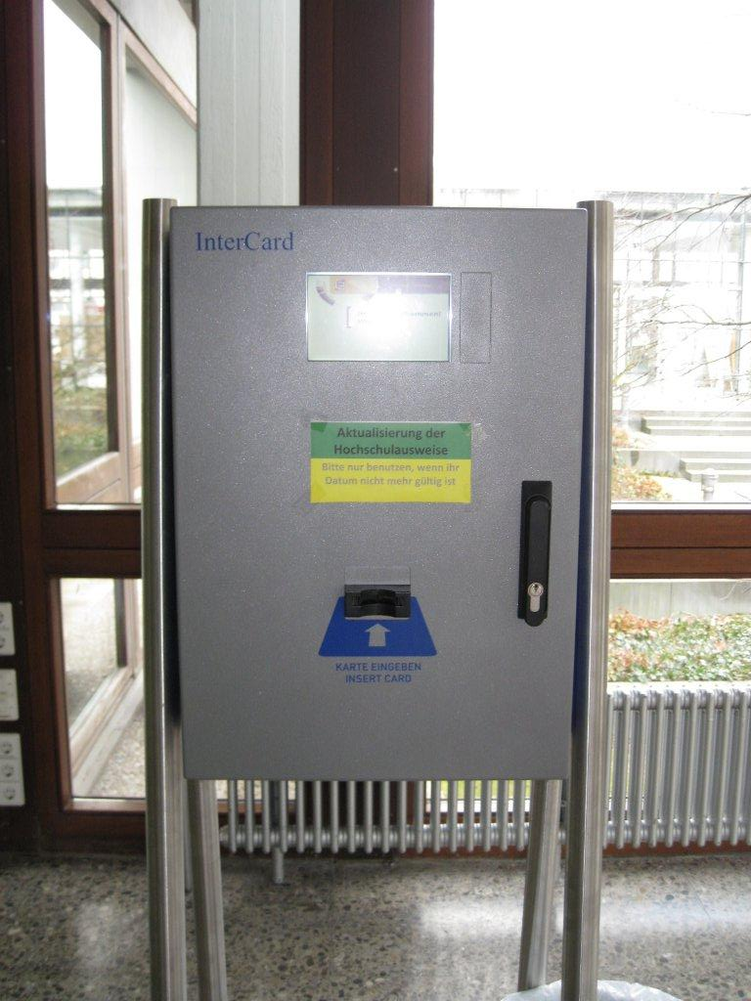
Your student ID
Validity of ID (current semester)
For students staying two semesters: needs to be validated every semester
at one of the blue terminals in W1 building

Slide 7

Problems with ID card?
General problems with ID card (damage, loss) → please go to the student service center (StudiCenter) in W1 building
  → Please handle your ID card with care – in case of loss or damage you will have to pay a replacement fee of 20 €
Problems with door opener? → please contact zutrittskontrolle@hs-pforzheim.de

Slide 8
Problems with ID card?
Problems with multifunctional printer or money charging → please contact HIZ – IT Service center in room W2.2.17
Office hours (please also check):
Mondays | 10:00am-11:30am
Tuesdays | 10:00am-11:30am
Wednesdays | 10:00am-11:30am
Thursdays | 10:00am-11:30am

Slide 9
Your user account
Why do you need a user account?
to use PC, Internet, VPN (wireless LAN)
and to activate your student ID
How do you activate your user account and your student ID?
→ you need to log in to one of the pcs at Pforzheim University
→ first login: you will receive your user-ID from International Programs Office together with your student ID

Slide 10
Your user account
Default password for first login is your birthday:
→ combination: ddmmyyyy
→ example: 08121990 (December 8, 1990)
Please change default password!
→ at pc lab you can change password or through logging into the university email system and changing it there.
→ do not use umlauts like äöü or symbols or email address
→ problems with your user account or password → please go to HIZ – IT Service center room (W2.2.17) → office hours see p. 8

Slide 11
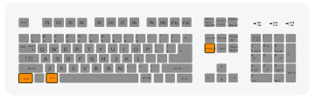
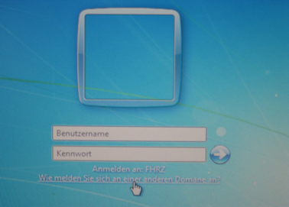
Your user account
There are two different operating systems at our computers labs:
Step 1
Step 2
„STRG+ALT+ENTF“
(ctrl-alt-del)
If you access your account through your private computer
(tablet, laptop or smartphone)
your username is:
Username: fh\userid
Username: userid
Password: default password

Slide 12

Your user account
When will my login be blocked?
3x incorrect log in attempts
wait 30 min. and try again
Problems? Where do I get support?
building W2 Room W2.2.17 (HIZ – IT Service)

Slide 13

Your email address at the Hochschule
To use your Pforzheim University´s email account, your address is :
userID@hs-pforzheim.de
URL to access email account via webmail:
http://webmail.hs-pforzheim.de
In order to log in via web and wireless:
You have to use fh\userID

Slide 14
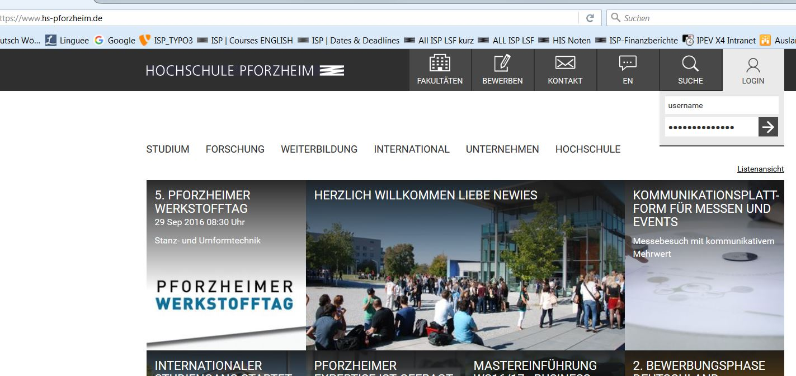
Webmail Access
Step 1: Log in to e-campus

Slide 15
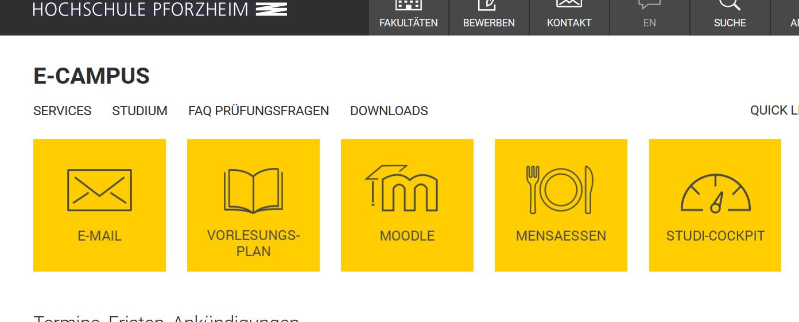
Webmail Access
Step 2: Click E-MAIL

Slide 16
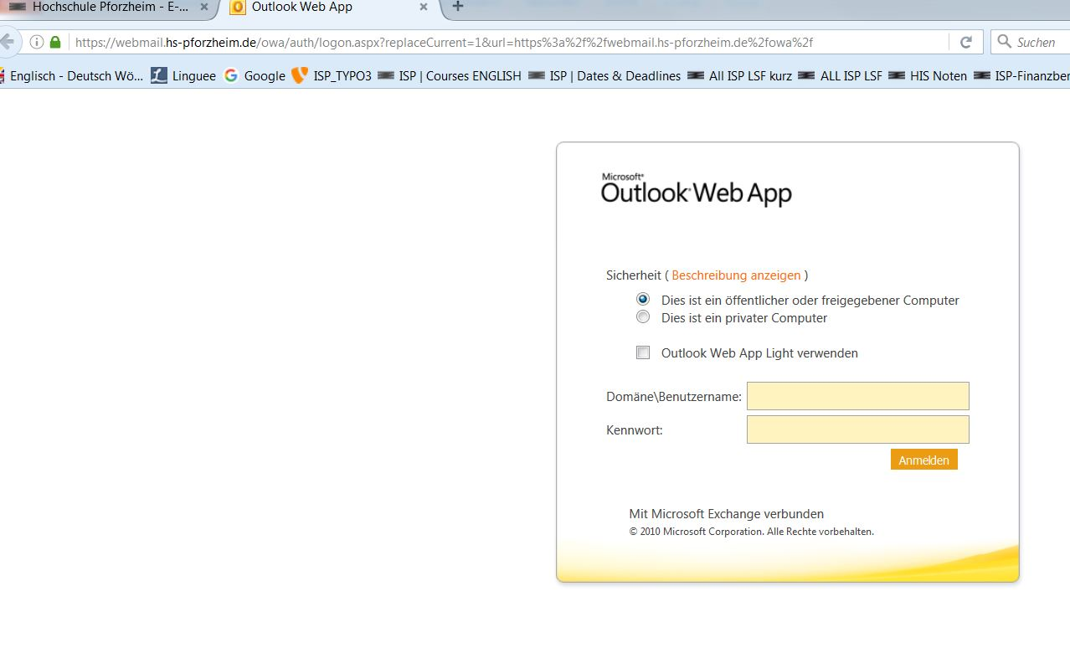
Webmail Access
Step 2: Log in

Slide 17

Computer Labs
Computer labs accessible without special permission (student ID card as door opener):
Lab in room W2.2.12 (seminar room – check schedule)
Lab in library Mediathek

Slide 18

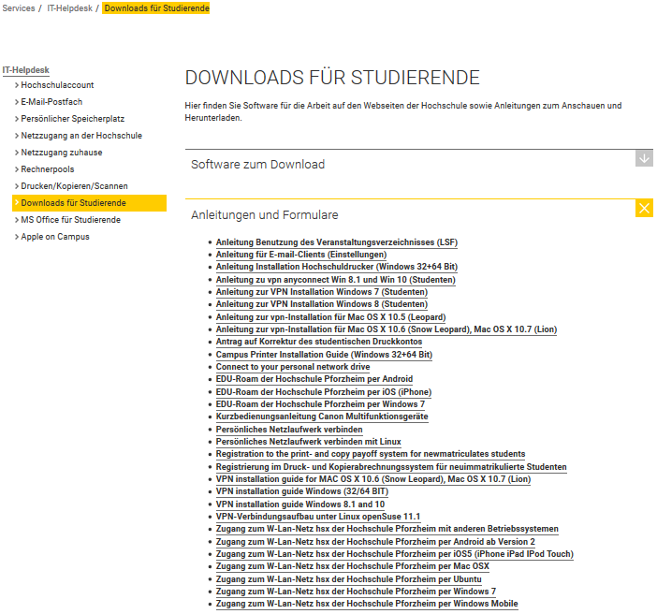
Wireless Internet
On campus you can access the wireless LAN via „hsx“ cloud
Unfortunatley the installation guide is not available in English
Link : https://e-campus.hs-pforzheim.de/services/it_helpdesk/downloads_fuer_studierende/
Once„hsx“ is installed it will connect automatically
hsx works with smartphones
username: fh\userid
password: default password

Slide 19
EDU-Roam Wireless Option
eduroam (education roaming)is an international roaming service in higher education. It provides secure network. access.
Follow similar step like the “hsx” guide.
The installation guides are unfortunately not available in English.
Note: if you use Eduroam on campus there might be restricted access due to safety reasons – better use it outside of campus

Slide 20
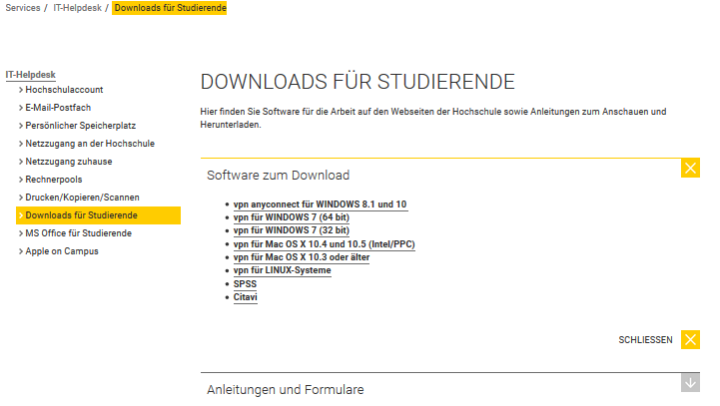
Wireless Internet
For access from you need to download the software „Cisco VPN client“

Slide 21
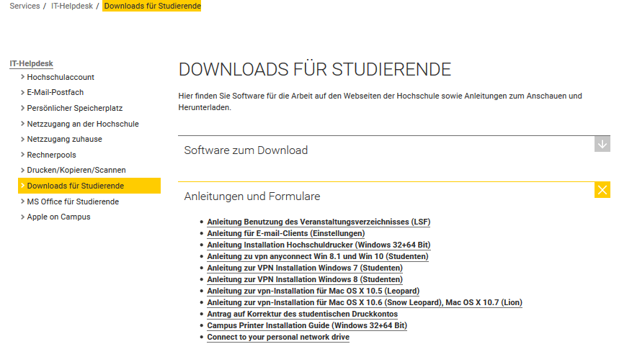
Wireless Internet
Please proceed as advised in the VPN installation guide

Slide 22
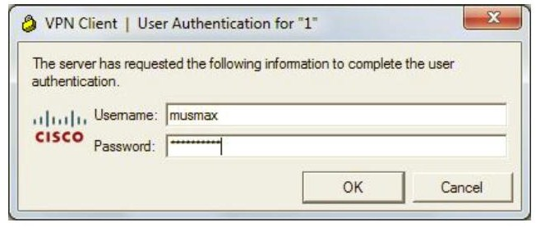
VPN client – login screen
Note:
If you log in with the VPN client outside of campus, you‘ll be able to use your personal University Pforzheim network drive.
Your login: userid
Personal password

Slide 23
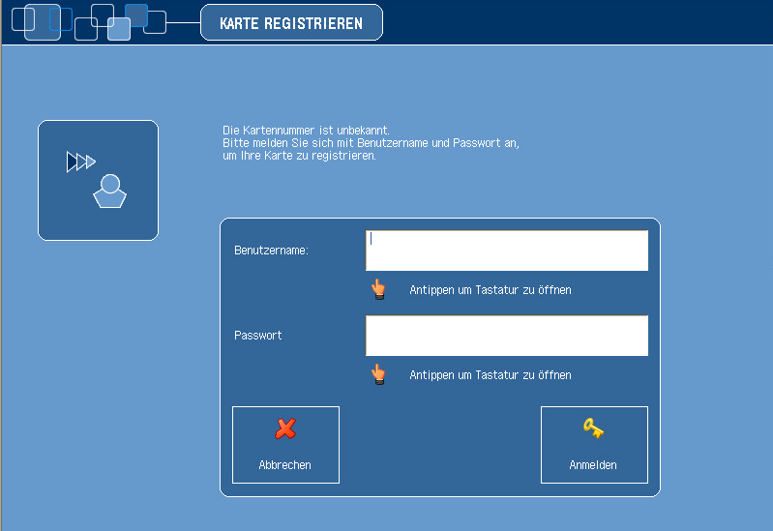
Multifunction Printer (+ Copier)
First usage to initialize printing (and your student ID)
only possible if you have already activated your user account (previous slides) and changed password
Go to one of the multifunction print/copy machines
Put your student ID on card reader
You will see this screen
Enter your user ID and new
personal PW
Notes:
Detailed instruction on HIZ homepage slide 13

Slide 24
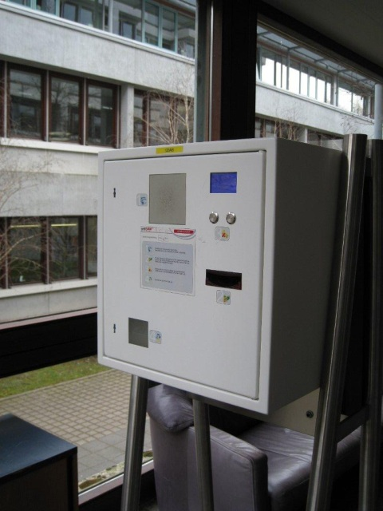
Multifunction Printer (+ Copier)
For the next logins, no identification except the scan of ID card is necessary
Never forget to log out (logout button or put ID on card reader again)
To print you need to charge your card with money at the white terminals in W1 building – 1st floor (opposite to student initiative)
  → Prices for A4: 3 cent b/w and 10 cent color per copy

Slide 25
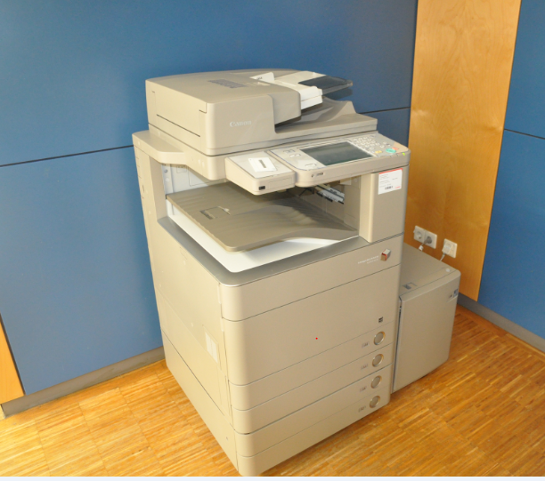
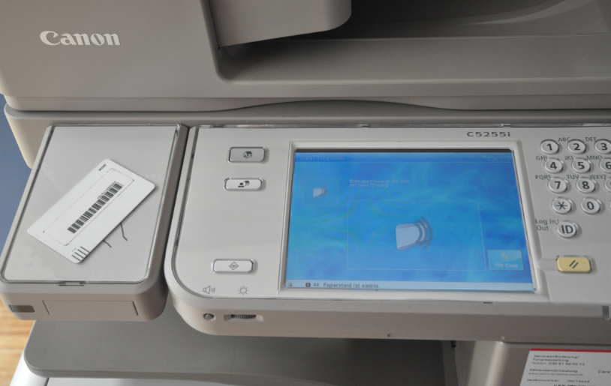
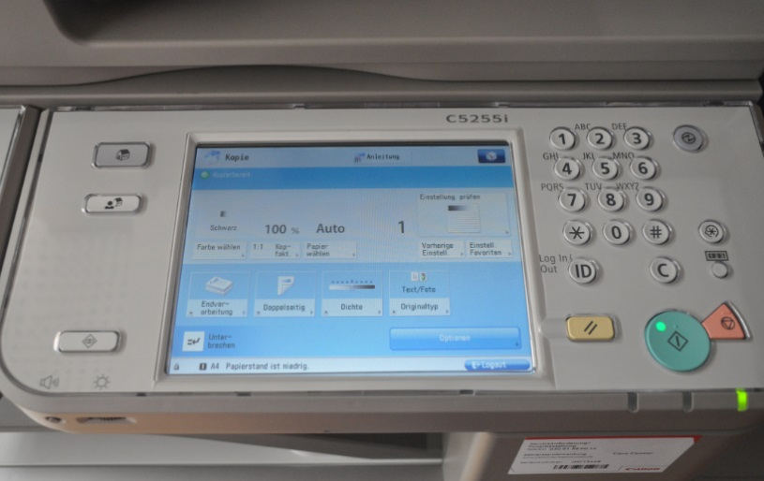
Instructions
card reader for
student ID
input field
touchscreen

Slide 26

standby
on-off
start
Here you can select the main functions:
„Kopie“ means copy (default function)
„Senden“ means scanning and sending to your webmail account
„—>“ and the arrow opens printing (from account or USB flash drive)

Slide 27
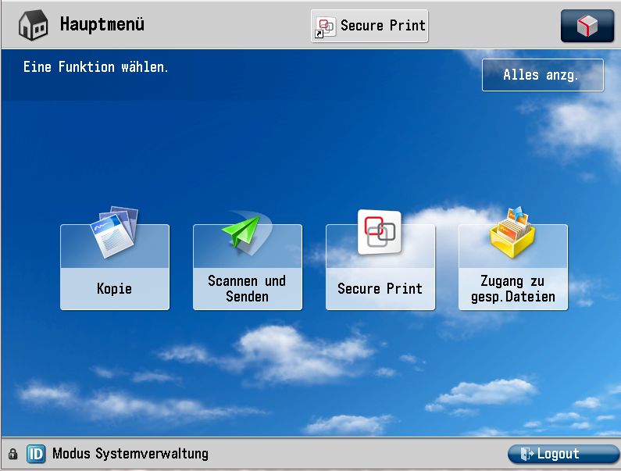


Screen at new multifunction printer (Canon)
copy
scan
Print via PC
Print via flash drive

Slide 28
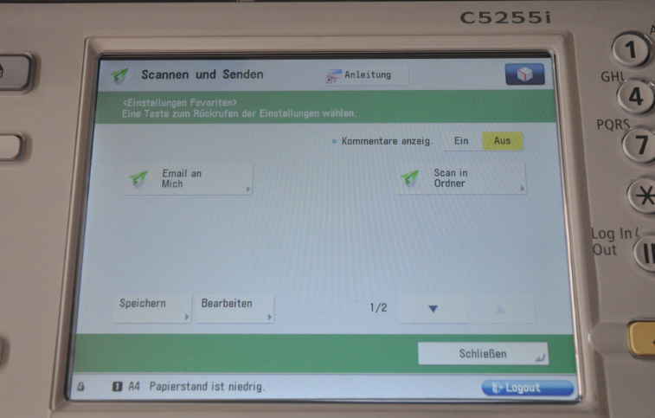
How to SCAN and send document to email or folder
Select „Scannen und Senden“
Scan and Send to your email adress (Email an mich) (xxxyyyzz@hs-pforzheim.de )
Only to hs-pforzheim webmail account possible!

Slide 29
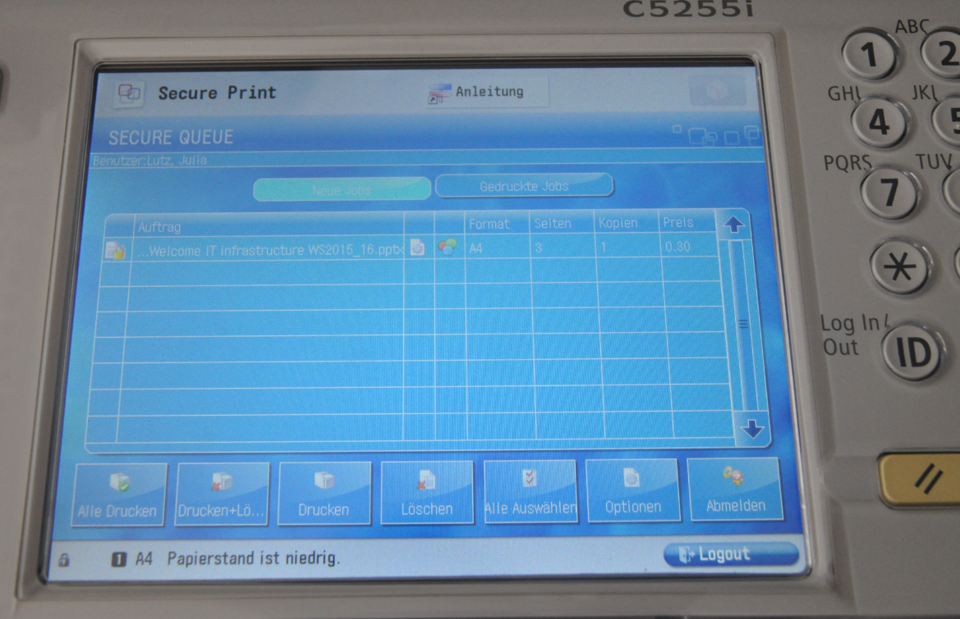
How to print a document
Here you can choose the printing job (you can select all / Alle Drucken)
Here you start printing
Info: to print from your personal computer you need to install the Pforzheim university printer – installation guide you‘ll find on the IT service internet page (slide 18)

Slide 30
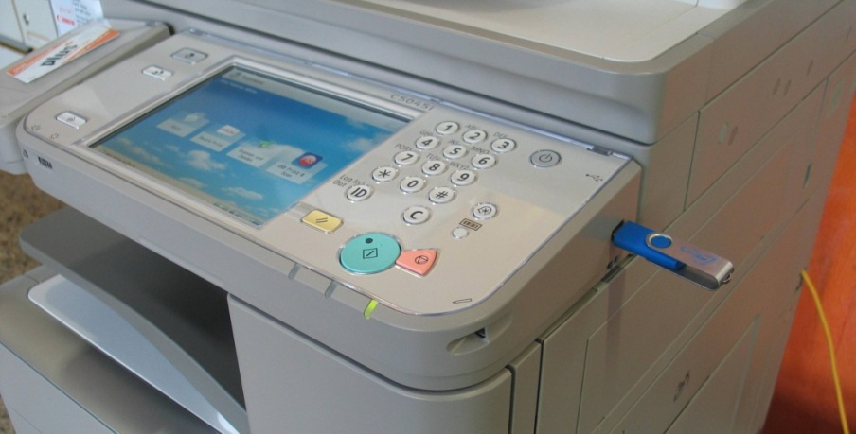
How to print a document
Canon printer
Step 1
Step 2
Using your flash drive at the multifunction devices - you can only print pdf-files!

Slide 31
E-campus Access
Step 1: Log in to e-campus from the HS homepage

Slide 32
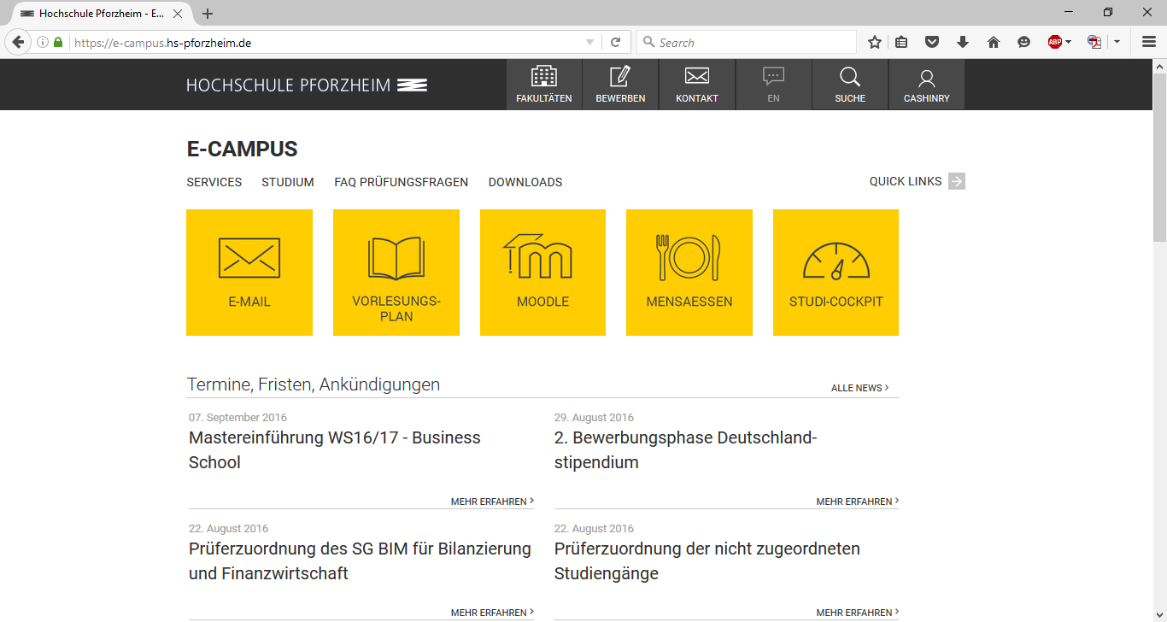
E-campus
Direct access to E-Mail, Lecture plan, Moodle, Cafeteria plan, and much more.

Slide 33
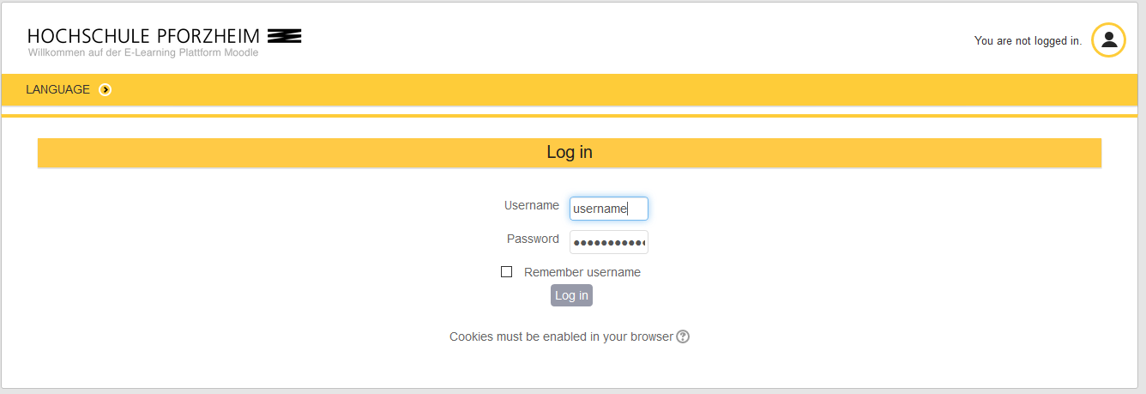
E-learning - How to find your course in “Moodle”
Exemplary illustration / course registration
Go to www.hs-pforzheim.de
Log in to e-campus (see previous slides)
Click “Moodle” and log in

Slide 34
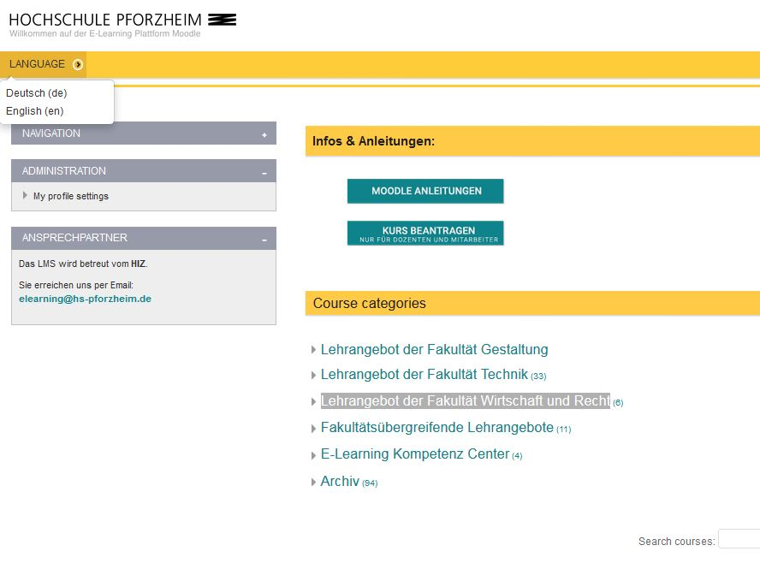
E-learning: How to find your course in Moodle (2)
Choose language (“Sprache”)
(a) Enter course ID in “search courses” field - OR:
(b) Choose school: e.g. Business School = “Lehrangebot der Fakultät Wirtschaft uund Recht”
… see next page

Slide 35
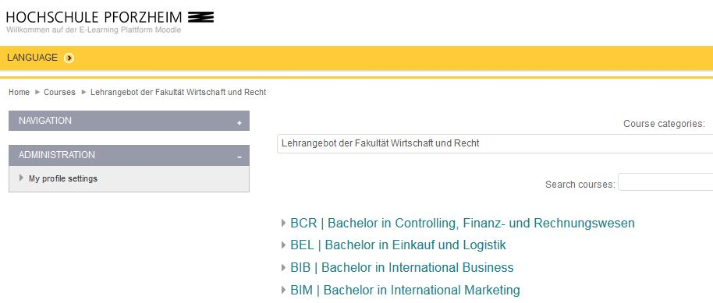
E-learning: How to find your course in Moodle (3)
(a) (Double) Degree Students
-> choose your Bachelor e.g. “BIM”
(b) Exchange Students
-> choose International Study
Program

Slide 36
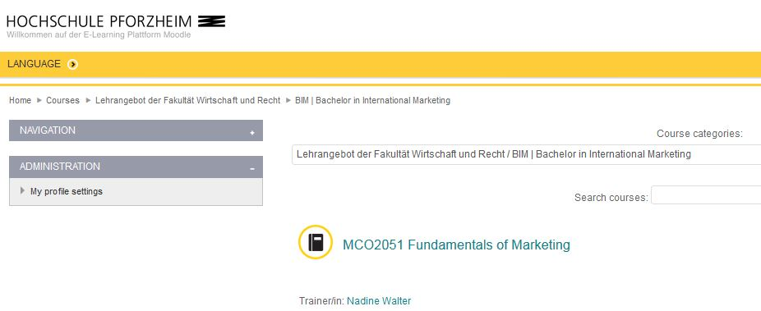
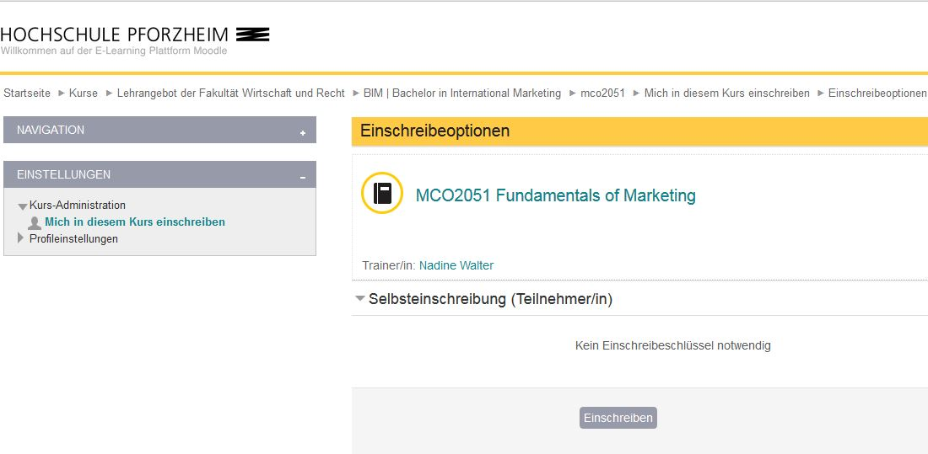
Moodle (4) -> course registration
choose your course
Enroll (“Einschreiben”) for the course
+ enter the password if applicable

